Slide 1
MGMT-6064 PROJECT LEADERSHIP AND MANAGEMENT
Module 10: Special Topics - Diversity, Virtual Teams

Slide 2
Topics for this module
Diversity:
Cross-cultural challenges
Gender and leadership
Virtual teams
Notes:
Source of material for slides: Arora

Slide 3

Cross-cultural diversity
Diversity: all of the ways in which people differ (e.g., race, gender, family status, socio-economic status, etc.)
Benefits of Diversity: people feel valued for their contributions, greater organizational learning and flexibility, diversity of thought, improved decision-making and problem-solving
“Homogeneous teams, on average, perform better than diverse teams … BUT… the best diverse teams outperform the best homogenous teams”
Notes:
Image Source: https://www.google.ca/url?sa=i&source=images&cd=&cad=rja&uact=8&ved=2ahUKEwi-_sXU8eDcAhUCoYMKHUGdADwQjRx6BAgBEAU&url=https%3A%2F%2Fwww.rotaryclubsofiacapital.org%2F2018%2F02%2F&psig=AOvVaw1goqV24xWKmOh8gu_KXl9E&ust=1533935585016183
Information Source: Assigned reading (Daft)
Source for Quote: Based on global survey of virtual teams (2014)
(Trends in Global Virtual Teams (excerpts)): https://www.youtube.com/watch?v=pxHk3WPJjdM) (17:20 in video)

Slide 4
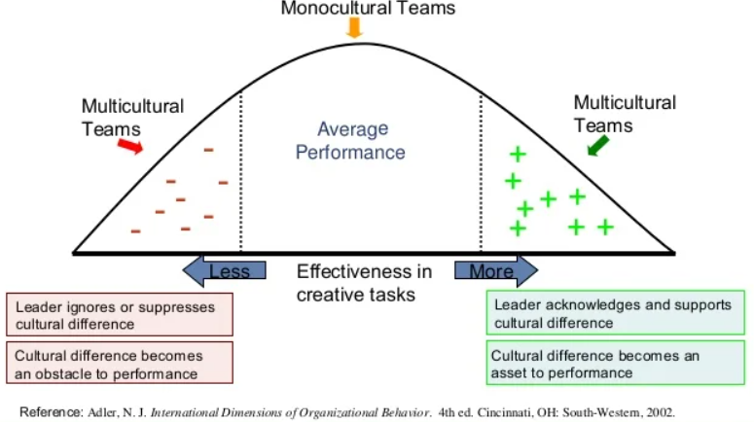
Cross-cultural diversity
“Homogeneous teams, on average, perform better than diverse teams … BUT… the best diverse teams outperform the best homogenous teams”

Slide 5
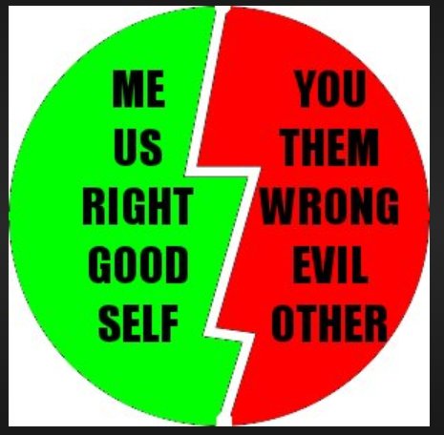


Challenges faced by minorities
Tendency for people to align/associate with people who are like them (homophily)
Tendency for people to have an ethnocentric ‘us versus them’ mentality
People have assumptions about other cultures and roles (stereotypes)
Minority groups experience “opportunity gaps”
Results in:
Overt and passive discrimination
“Glass ceiling”
(link)
Notes:
Information Source: Assigned reading (Daft)
Images: http://iambenjaminlong.com/wp-content/uploads/2012/01/usvsthem.jpeg
http://letters2mindanao.files.wordpress.com/2009/07/glassceiling72.jpg

Slide 6

As a leader and role model, how are you going to address diversity issues with your project team and your project stakeholders?
Identify your sensitivity and openness to other cultures, attitudes, values, and ways of doing things (Personal Diversity Awareness Model)
and
Develop Cultural Intelligence (CQ)
Notes:
Image: https://static.scs.georgetown.edu/upload/catalog/programs/webfeatures/business-team-working-on-project.jpg

Slide 7
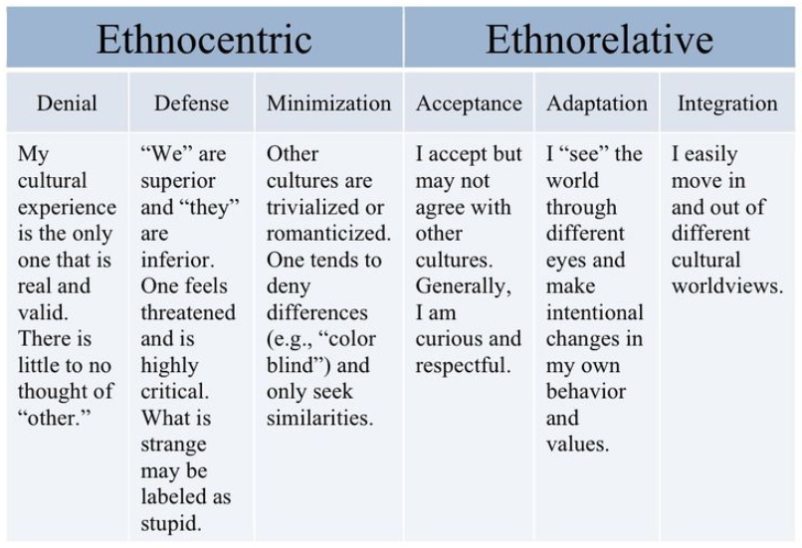
personal Diversity awareness Model (Bennett’s developmental model of intercultural sensitivity - DMIS)
Notes:
Source: https://s-media-cache-ak0.pinimg.com/736x/cc/f0/0a/ccf00a70682fec71591dfe7689df61da.jpg

Slide 8

Cultural intelligence (CQ)
Culturally different social/business practices can lead to misunderstandings
Cultural Intelligence: ability to interpret and adapt to culturally unfamiliar situations
Cognitive: observational and learning skills, ability to notice and interpret cross-cultural clues to understanding
Emotional: self-confidence and willingness to learn about different cultures, willingness to self-reflect and change your behaviour
Physical: ability to shift speech, expressions, body language to align with different cultures
Notes:
Image: http://cdn.pursuegod.org/wp-content/uploads/cultural-intelligence-1000x640.jpg
Information Source: Assigned reading (Daft)

Slide 9
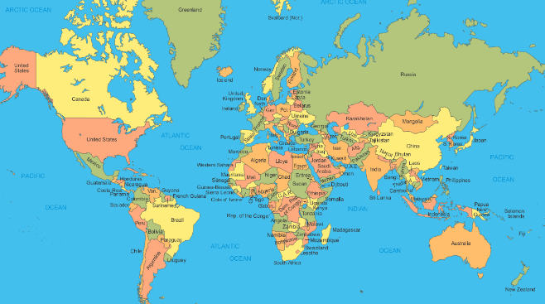
Hofstede’s cultural dimensions
Six cultural dimensions :
Power Distance
Individualism
Masculinity
Uncertainty Avoidance
Long Term Orientation
Indulgence
Notes:
Image: https://www.bing.com/images/search?view=detailV2&id=32B0EFEE2E415901E3A15F781EB477D8BAE4DA61&thid=OIP.yGauageDtllGq6kJxutxHQHaEa&mediaurl=https%3A%2F%2Fwhat5.files.wordpress.com%2F2012%2F09%2Fworld-map.gif&exph=715&expw=1200&q=world+map&selectedindex=1&ajaxhist=0&vt=0

Slide 10
Technology and culture (Kerzner)
Cultural Factor | Technological Considerations
Power Distance | High power distance cultures: May prefer asynchronous technologies that allow anonymous input, may use technology to increase or maintain status differences between members
Uncertainty Avoidance | High uncertainty avoidance cultures: May be slow adopters of technology, may prefer technologies that create ‘audit trails’
Individualism-Collectivism | High collectivistic cultures: May prefer face-to-face interactions
Masculinity-Femininity | Highly feminine cultures: May prefer to use technology in a nurturing and collaborative way, especially at start-up
Context | High context cultures: May prefer information-rich or social emphasis technologies Low context cultures: May prefer asynchronous communication
Notes:
Source: Kerzner 12e: p. 284

Slide 11

Gender and leadership
Notes:
Image: https://rismedia.com/wp-content/uploads/2019/03/women_leaders_925327900-1080x627.jpg

Slide 12
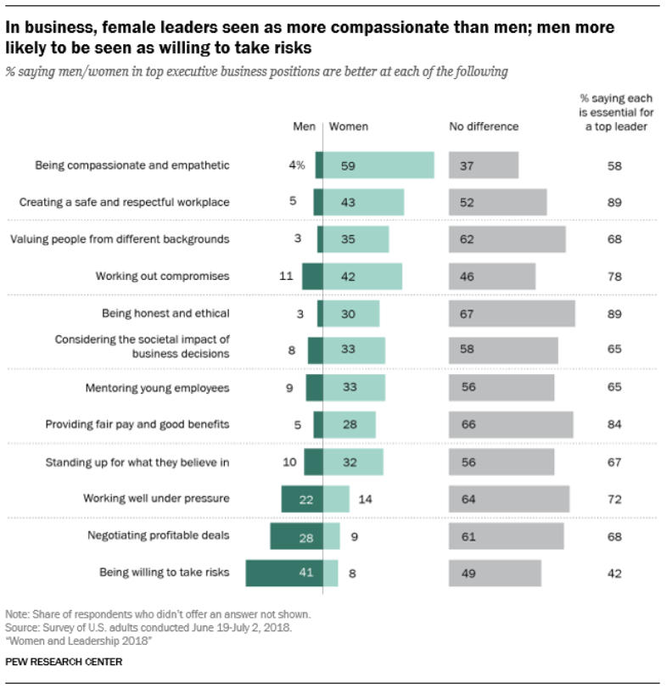
Gender and leadership
(U.S. research)
Men and women are not perceived to be different when it comes to leadership effectiveness
Men and women are perceived to be different when it comes to leadership styles and ‘soft skills’ (interpersonal skills, communication, adaptability, etc.)
(Note: You don’t have to memorize the left half of this slide for the exam, but you may be asked about information on the right side of this slide)
Notes:
Source of graph:
https://www.pewsocialtrends.org/2018/09/20/2-views-on-leadership-traits-and-competencies-and-how-they-intersect-with-gender/
These findings are consistent with Canadian Research, such as:
Conference Board of Canada report: “Women in Senior Management: Where Are They?” http://www.lesaffaires.com/article/download/id/383
Advancing Women in Leadership: Business Case (Professional Accountants in Canada) https://www.cpacanada.ca/en/career-and-professional-development/professional-development-resources/teamwork-and-leadership-skills/advancing-women-in-leadership-q-and-a

Slide 13
Gender comparison – Project managers (PMI 12th annual Salary Survey)
 | # Respondents |  | % of Respondents |  | Median Salary
Country | Male | Female | Male | Female | Male | Female | Salary Gap
Australia | 670 | 210 | 76 | 24 | 150000 | 134000 | 11%
Brazil | 702 | 147 | 83 | 17 | 180000 | 150000 | 17%
Canada | 2624 | 1457 | 64 | 36 | 107000 | 97500 | 9%
China | 362 | 139 | 72 | 28 | 200000 | 180000 | 10%
France | 332 | 112 | 75 | 25 | 63250 | 60000 | 5%
Germany | 649 | 149 | 81 | 19 | 90000 | 80000 | 11%
India | 1532 | 196 | 89 | 11 | 2000000 | 1700000 | 15%
Ireland | 222 | 112 | 66 | 34 | 80000 | 78753 | 2%
Italy | 1008 | 235 | 81 | 19 | 53000 | 48000 | 9%
Japan | 684 | 65 | 91 | 9 | 8000000 | 7400000 | 8%
Malaysia | 331 | 111 | 75 | 25 | 150000 | 130000 | 13%
Mexico | 543 | 157 | 78 | 22 | 840000 | 645000 | 23%
New Zealand | 194 | 71 | 80 | 29 | 125000 | 126000 | -1%
Singapore | 695 | 163 | 81 | 19 | 103090 | 90000 | 13%
South Africa | 353 | 155 | 69 | 31 | 1000000 | 862534 | 14%
Spain | 776 | 218 | 78 | 22 | 51000 | 45500 | 11%
Sweden | 168 | 71 | 70 | 30 | 669000 | 684000 | -2%
Switzerland | 277 | 92 | 75 | 25 | 135000 | 120000 | 11%
UAE | 715 | 76 | 90 | 10 | 250000 | 240000 | 4%
United Kingdom | 575 | 201 | 74 | 26 | 72000 | 60000 | 17%
United States | 3966 | 3486 | 53 | 47 | 120000 | 106000 | 12%
(Note: You are not required to memorize this slide for the exam)
Notes:
Data from 12th Edition of PMI's Project Management Salary Survey https://www.pmi.org/learning/careers/project-management-salary-survey Salary is expressed in country's local currency (full data for PMI members, summary for non-members)

Slide 14

VIRTUAL TEAMS
Notes:
Image: http://globalpeopletransitions.com/wp-content/uploads/2015/05/virtual-teams.png

Slide 15

virtual teams
Virtual teams: groups of geographically dispersed workers brought together by information technologies to accomplish one or more organization tasks
Enable utilization of the best people anywhere for the given project, without relocation
Benefits:
Reduced costs
Accelerated project time-lines
Lowered environmental impact
Access to diverse perspectives
Notes:
Source: Arora, M. & Baronikian, J. (2013). Leadership in project management: Leading people and projects to success (2nd ed.). Toronto: Leadership Publishing House.
Image: http://perkuto.com/wp-content/uploads/2015/02/virtual_team_1417085161-1.jpg

Slide 16
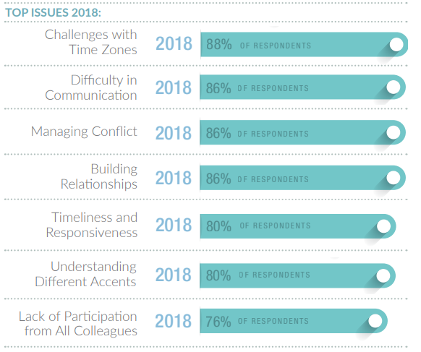
General Challenges of Virtual Teams (2018 survey)
(Note: You are not required to memorize numbers in this slide for the exam, but you may be asked a general question about top challenges of virtual teams.)
Notes:
https://cdn2.hubspot.net/hubfs/466336/VTS-ExecutiveSummary--Final.pdf?_ga=2.182946854.1202519274.1648692935-1914377065.1648692935
1620 respondents from 90 countries

Slide 17
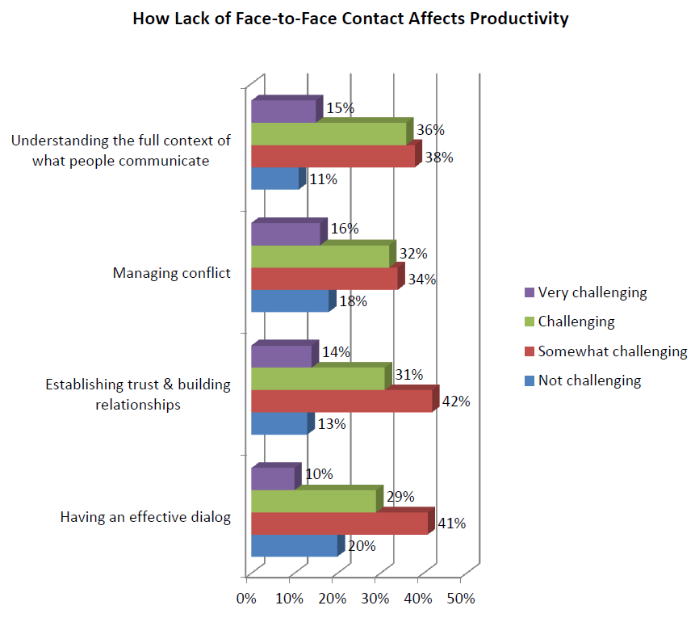
challenges due to lack of face-to-face contact on virtual teams (2016 survey)
(Note: You are not required to memorize numbers in this slide for the exam, but you may be asked a general question about top challenges of virtual teams.)
Notes:
Trends in Global Virtual Teams (Executive Summary, Key Findings, and Conclusions from Virtual Teams Survey Report – 2016)
Source: cdn.culturewizard.com/PDF/Trends_in_VT_Report_4-17-2016.pdf

Slide 18
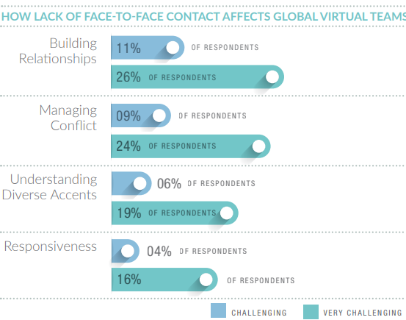
challenges due to lack of face-to-face contact on virtual teams (2020 survey)
(Note: You are not required to memorize numbers in this slide for the exam, but you may be asked a general question about top challenges of virtual teams.)
Notes:
https://cdn2.hubspot.net/hubfs/466336/VTS-ExecutiveBrief-2020-FInal.pdf?_ga=2.140936498.1202519274.1648692935-1914377065.1648692935
Nearly 2700 respondents from 106 countries

Slide 19
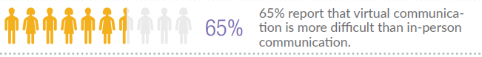
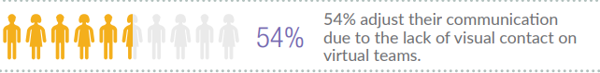
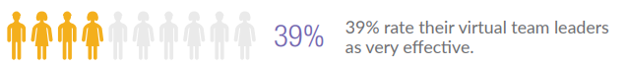
Key findings (2020 survey)
(% of respondents in agreement with statement)
(Note: You are not required to memorize numbers in this slide for the exam, but you may be asked a general question about these findings.)
Notes:
https://cdn2.hubspot.net/hubfs/466336/VTS-ExecutiveBrief-2020-FInal.pdf?_ga=2.140936498.1202519274.1648692935-1914377065.1648692935 (Culturewizard biennial survey)
Nearly 2700 respondents from 106 countries

Slide 20

recommendations and best practices for global virtual teams
Team charter
Agenda
Summary notes
Time-zone rotation
Build and maintain trust
Make time to develop relationships
Ensure participation
Clarify if language difficulties
Offline discussions
Notes:
http://cdn.culturewizard.com/PDF/Trends_in_VT_Report_4-17-2016.pdf
Virtual Teams Survey Report – 2016 from RW3 Culture Wizard
Image: http://images.rigzone.com/images/news/articles/n_147906.png

